Slide 1
STORED PROCEDUREs

Slide 2
agenda
Introduction to Stored Procedures
Benefits
Types
Syntax
Stored procedures using Parameters
Without Parameters
Input Parameters
Output Parameters
Input and Output Parameters
Rename, Modify and Delete

Slide 3
Introduction to Stored Procedures
A prepared SQL code that you can save, so the code can be reused repeatedly.
You can also pass parameters to a stored procedure, so that the stored procedure can act based on the parameter value(s) that is passed.

Slide 4
Benefits of Stored Procedures
Reduced server/client network traffic
Stronger security
Reuse of code
User-defined
Exception Handling

Slide 5
Types of Stored Procedures
System Defined Stored Procedure
Eg: sp_rename, sp_help, sp_helpindex
Extended Procedure
Provide an interface to external programs for various maintenance activities.
These extended procedures start with the xp_ prefix and are stored in the Master database.

Slide 6
Types of Stored Procedures
User-Defined Stored Procedure
CLR Stored Procedure
based on the CLR (Common Language Runtime) in the.net framework.
Allows for the procedure to be coded in one of the .NET languages like C#, Visual Basic, and F#.

Slide 7
Syntax for Stored Procedures
CREATE PROCEDURE procedure_name AS sql_statement GO;
EXEC procedure_name;

Slide 8
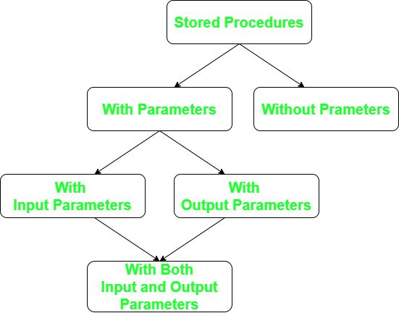
Stored procedures using Parameters

Slide 9
Stored procedures without parameters
CREATE PROCEDURE sp_SelectAll
AS
SELECT * FROM Products
GO;
EXEC sp_SelectAll;

Slide 10
Stored procedures with INPUT parameters
create procedure sp_insert_record
@val1 int,
@val2 VARCHAR(20),
@val3 int,
@val4 int,
@val5 VARCHAR(20)
as
begin
insert into Products VALUES(@val1,@val2,@val3,@val4,@val5);
end
exec sp_insert_record @val1=4321, @val2='Smart Watch', @val3=3, @val4=5000, @val5='Gadgets';

Slide 11
Stored procedures with outPUT parameters
create procedure sp_inputp(@Name varchar(10) output)
as
begin
select Name from Products where ProductId=6669
end
declare @en varchar(10)
exec sp_inputp @Name=@en output
print @en

Slide 12
Stored procedures with INPUT & outPUT parameters
create procedure sp_get(@name varchar(20) out, @id int)
as
begin
select Name from Products where ProductId=@id
end
declare @en varchar(10)
exec sp_get @en,6369
print @en

Slide 13
Renaming stored procedures
EXEC sp_rename 'Current procedure_name', 'New procedure_name’;
Object Explorer → Programmablility → Stored Procedures → Rename

Slide 14
Modifying stored procedures
Object Explorer → Programmablility → Stored Procedures → Modify
ALTER PROCEDURE sp_mod_Procedure
@first_name varchar(20),
@last_name varchar(20)
AS
BEGIN
SELECT @last_name + ', ' + @first_name;
END
EXEC sp_mod_Procedure 'Susmith', 'Reddy';

Slide 15
Deleting stored procedures
Object Explorer → Programmablility → Stored Procedures → Delete
DROP PROCEDURE IF EXISTS dbo.pr;

Slide 16
Thank you
By
D Susmith Reddy

